Slide 1
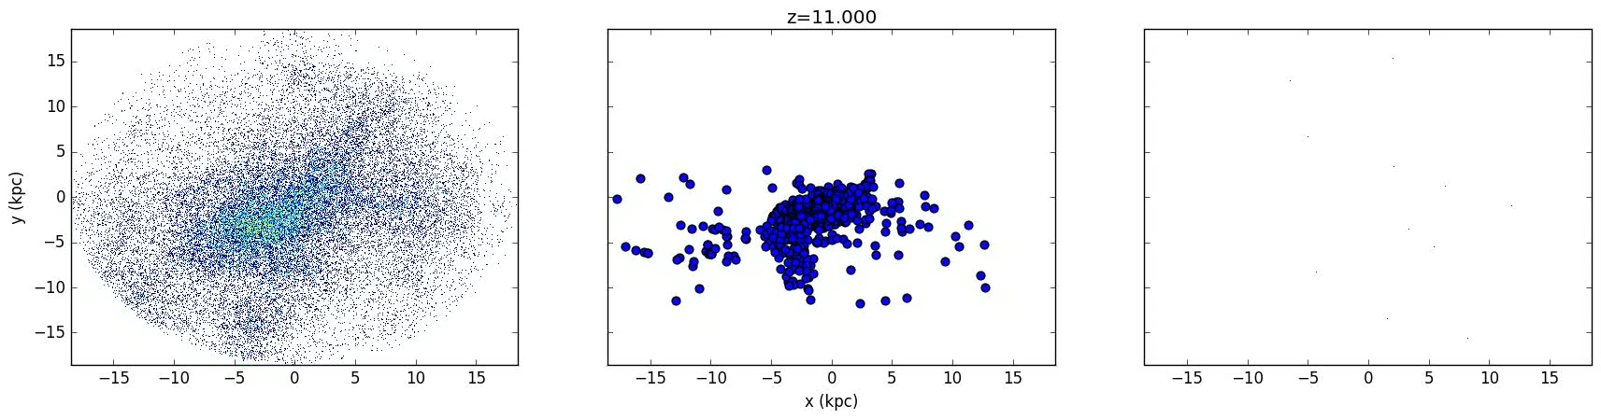
No assembly required Low mass dwarf galaxy formation has little dependence on galaxy mergers
Alex Fitts - Ut austin
Mike Boylan–Kolchin – UT Austin
James Bullock – UCI
Dan weisz – UC berkeley
and the fire team
Ut austin theory seminar 10/09/2017

Slide 2
Why low mass dwarf galaxies?

Slide 3
Why low mass dwarf galaxies?
ΛCDM predicts large scale structure extremely well

Slide 4
Why low mass dwarf galaxies?
ΛCDM predicts large scale structure extremely well
Questions remain at smaller scales

Slide 5
Why low mass dwarf galaxies?
ΛCDM predicts large scale structure extremely well
Questions remain at smaller scales
Dark matter theory? Galaxy Formation?

Slide 6
Why low mass dwarf galaxies?
ΛCDM predicts large scale structure extremely well
Questions remain at smaller scales
Dark matter theory? Galaxy Formation?
Interesting scale at M_{vir}~10¹⁰ M, M★~10⁶ M

Slide 7
How important are galaxy mergers for low mass galaxies?

Slide 8
How important are galaxy mergers for low mass galaxies?
How does galaxy assembly compare to the hierarchical buildup of DM halos?

Slide 9
How important are galaxy mergers for low mass galaxies?
How does galaxy assembly compare to the hierarchical buildup of DM halos?
Stellar fossil record of Local Group dwarfs
Notes:
Ex situ fraction?

Slide 10
How important are galaxy mergers for low mass galaxies?
How does galaxy assembly compare to the hierarchical buildup of DM halos?
Stellar fossil record of Local Group dwarfs
Implications for near field cosmology
Notes:
Weisz 2014

Slide 11
How important are galaxy mergers for low mass galaxies?
How does galaxy assembly compare to the hierarchical buildup of DM halos?
Stellar fossil record of Local Group dwarfs
Implications for near field cosmology
Are certain observed features actually associated with mergers?
Notes:
Dwarf-dwarf mergers can create dSphs (Moore et al. 1996; Kazantzidis et al. 2011b), and the mechanism is satisfyingly similar to models proposed for transforming massive disks into giant ellipticals (Icke 1985).

Slide 12
Simulation details
GIZMO MFM code
Updated FIRE-2 feedback suite
15 isolated dwarfs at M_{halo}~10¹⁰ M
ε_{gas}~ 2 pc ε_{dm}~35 pc
M_{gas}~ 500 M, M_{dm}~ 2500 M
35³ Mpc³ box
Notes:
halos at z=0 have on the order of 1e6 dm particles and 1e4 star particles

Slide 13
Mass assembly histories
Fitts et al. (in prep)

Slide 14
Mass assembly histories
Fitts et al. (in prep)

Slide 15
M★-M_{halo} relation throughout time
Fitts et al. (in prep)
Notes:
this is very difficult to constrain observationally, making simulations an important guide

Slide 16
M★-M_{halo} relation throughout time
Behroozi et al. (2018)
extrapolated
Fitts et al. (in prep)

Slide 17
M★-M_{halo} relation throughout time
Fitts et al. (in prep)

Slide 18
V_{max} through time

Slide 19
M★-M_{halo} relation throughout time
Fitts et al. (in prep)

Slide 20
Average merger history
Fitts et al. (in prep)

Slide 21
Average merger history
Fitts et al. (in prep)

Slide 22
Average merger history
Fitts et al. (in prep)

Slide 23
In situ formation domination
Fitts et al. (in prep)

Slide 24
In situ formation domination
Fitts et al. (in prep)

Slide 25
In situ sfh vs accreted SFH

Slide 26
In situ sfh vs accreted SFH

Slide 27
Dmo vs hydro predictions
Fitts et al. (in prep)

Slide 28
Satellites of dwarfs
Fitts et al. (in prep)

Slide 29
Satellites of dwarfs
Increasing resolution
Fitts et al. (in prep)

Slide 30
Conclusions
Isolated dwarf galaxies do not receive a significant portion of their stellar mass from galaxy mergers
Validates using stellar fossil record to trace SFH of dwarfs
Virtually all galaxy mergers occur during the early assembly phase of the dwarf
All stars contributed by galaxy mergers are uniformly ancient
DMO simulations do an accurate job predicting the # of mergers
Added bonus: Further evidence that UFD satellites may exist around dwarf galaxies in the field

Slide 31
extras

Slide 32
M★-M_{halo} relation at z=0
Garrison-Kimmel et al. 2016

Slide 33
HI brought in from mergers

Slide 34
Metal Distributions

Slide 35
Metal Distributions

